Slide 1
Theory of Automata
2PDA
Week 13

Slide 2
Contents
Two Stack PDA
Just another TM “2PDA = TM”
Simulate a TM over PM
nPDA = TM
Theory of Automata

Slide 3
2PDA or Two Stack PDA
Let us define a two-stack pushdown automaton
as follows
M = (K, Σ, Γ, Δ, s, F)
K is a finite set of states,
Σ is an alphabet (the input symbols),
Γ is an alphabet (the stack symbols),
s ∈ K is the start state,
F ⊆ K is the set of final states, and
Finite set of transition from one state to another state
Theory of Automata

Slide 4
2PDA
As we have two stacks for storage purpose, so change the name of POP and PUSH stack accordingly.
POP₁ will pop from the first stack
POP₂ will pop from the second stack
PUSH₁ will push into first stack
PUSH₂ will push into second stack
Theory of Automata

Slide 5
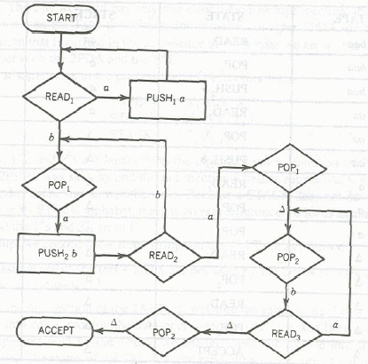
Guess the Language
a^{n}b^{n}a^{n}
Theory of Automata

Slide 6
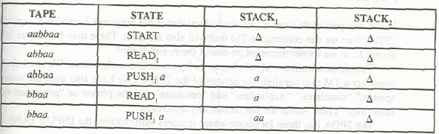
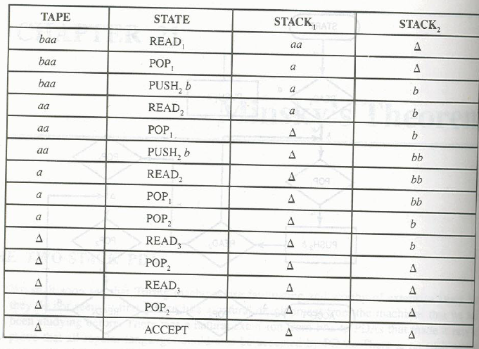
\
Run
aabbaa
Theory of Automata

Slide 7
Just another TM “2PDA = TM”
Minsky’s Theorem
Theorem:
Any language accepted by a 2PDA can be accepted by some TM and any language accepted by a TM can also accepted by 2PDA.
Proof :
2PDA has 3 locations for storage
  Stack1
  Stack2
  Input Tape
Theory of Automata

Slide 8
2PDA = TM
Step-1 assume # and $ are not used by 2PDA
Step-2 Divide TM into three parts
Insert ∆ in cell i.
First Part
contains input string
  We change each letter into ∆ as the letters are read by the 2PDA.
  Put # at the end of input strings as end marker
Second Part
Contains the Stack1 of the 2PDA
$ is placed as the end of stack1 contents over the input tape
Third Part
Contains the Stack2 of the 2PDA
will indicating the end of stack2 contents
Theory of Automata

Slide 9
Read simulation
TAPE x₁, x₂ x₃ x₄
STACK₁ Y₁ Y₂ Y₃ Y₄ Y₅
STACK₂ Z₁, Z₂
The input tape will be
⁭
After simulating any action of 2PDA TAPE HEAD will return to # before beginning its next operation
∆ | ∆ | ∆ | X₃ | X₄ | # | ….
Theory of Automata

Slide 10

After putting input string and two stack over the input TAPE of Turing machine, the Input TAPE will be as under
Theory of Automata

Slide 11
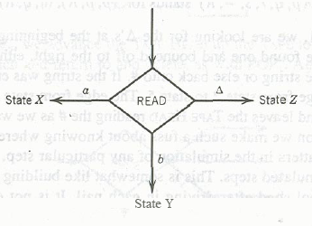
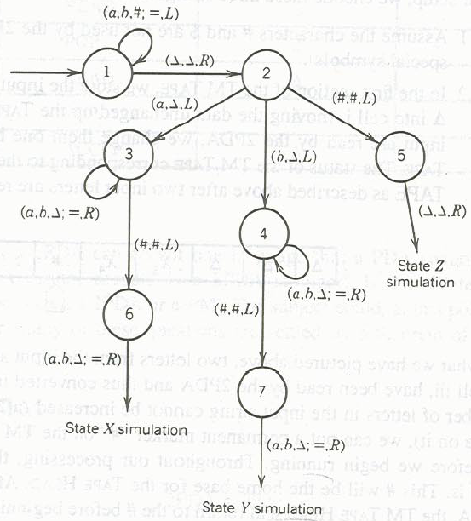
(a,b,#;=,L)
Above statement equals
(a,a,L)
(b,b,L)
(#,#,L)
Theory of Automata

Slide 12
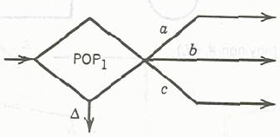
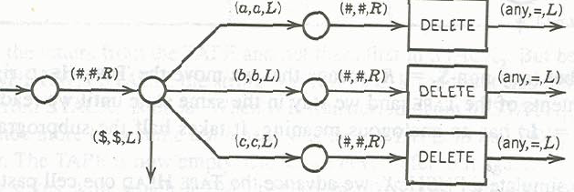
Simulate POP₁ instruction
Becomes
Theory of Automata

Slide 13
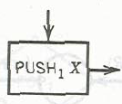

Simulating Push₁
Becomes
Theory of Automata

Slide 14
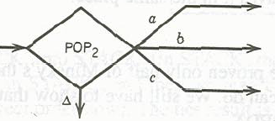
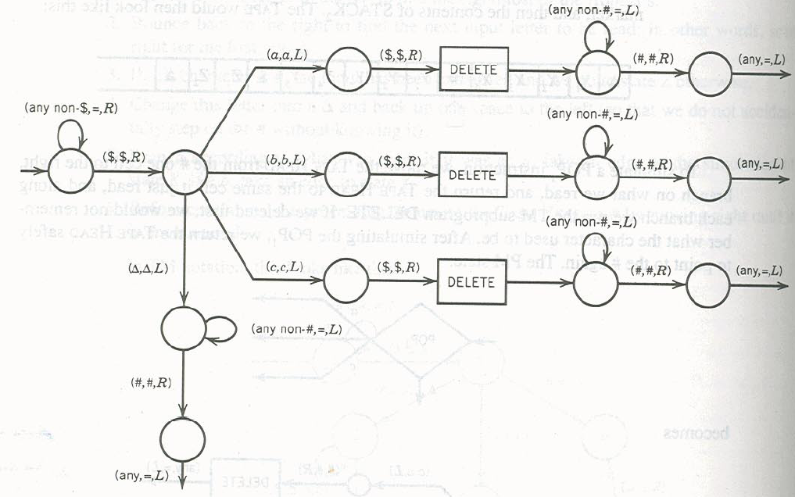
Simulating POP₂
Becomes
Theory of Automata

Slide 15

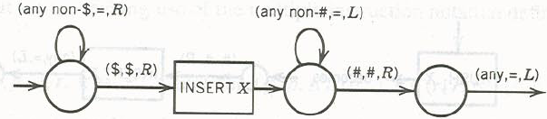
Simulating Push₂
Becomes
Theory of Automata

Slide 16
Simulate a TM over PM
This part will not be proved directly
We will make a 2PDA for PM and as we have already proved that PM=TM,
So indirectly it is proven that 2PDA = TM
We will do the above step for convenience as constructing 2PDA for PM is easier as compared to constructing 2PDA for TM.
Theory of Automata

Slide 17
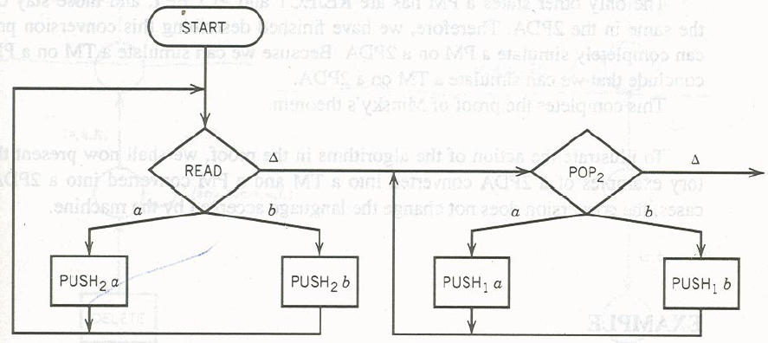
2PDA = PM
PM starts with input string already in the STORE, so we will store the input strings over the stack1 as follows
Theory of Automata

Slide 18
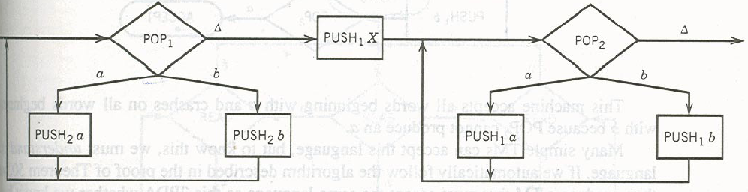
Simulating a ADD of PM
ADD of PM will add to right of string while push of 2PDA adds to left of the string.
Theory of Automata

Slide 19
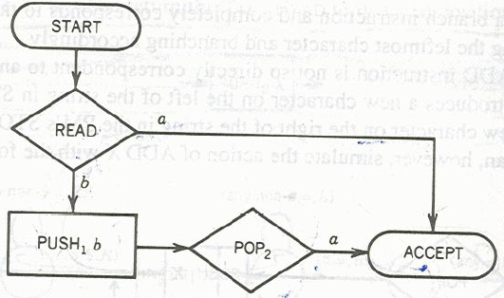
Construct a PM for following
Theory of Automata

Slide 20
nPDA = TM
Theorem 51
Any language accepted by a PDA with n STACKS
(where n is 2 or more), called an nPDA, can also
be accepted by some TM.
In power nPDA = TM
Theory of Automata

Slide 21
Theorem 51: PROOF
Suppose we have 3PDA (i.e. PDA with 3 stacks)
And the status is
TAPE w₁w₂w₃w₄
STACK₁ X₁X₂
STACK₂ Y₁ Y₂ Y₃ Y₄ Y₅
STACK₃ Z₁, Z₂Z₃
The input tape will be
⁭
∆ | ∆ | ∆ | w₁w₂w₃w₄ | #₁ | x₁x₂ | #₂ | y₁y₂y₃y₄y₅ | #₂ | z₁z₂ | ∆ | …
Theory of Automata

Slide 22
nPDA = TM
Remaining proof is the same as for 2PDA. So
nPDA = TM for n ≤ 2
Symbolically we can represent the power comparison of our various mathematical models of machines as follows.
FA = TG = NFA < DPDA < NPDA < 2PDA = nPDA = PM = TM
Theory of Automata

Slide 23
Problems
2 EQUAL
3 EQUAL
MOREa
DoubleWord
a^{n!}
a^{2^n} hint (chop the input into half at every iteration)
Delete SubProgram
Theory of Automata

Slide 24
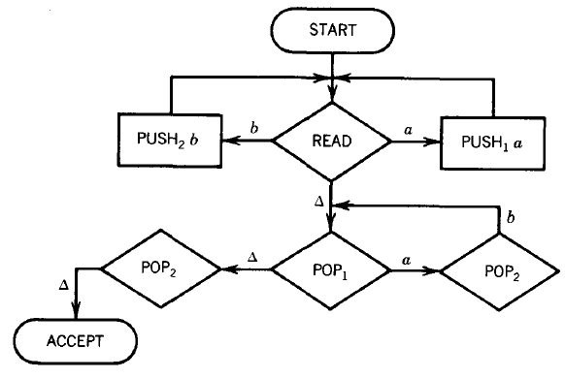
EQUAL EQUAL
Theory of Automata

Slide 25
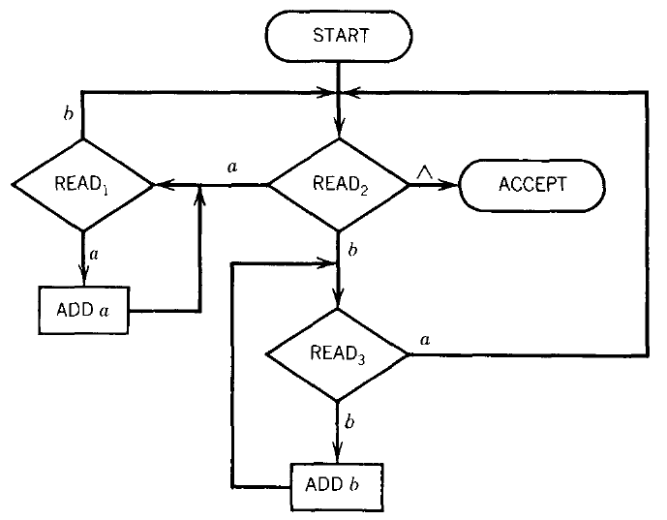
PM-EQUAL EQUAL
Theory of Automata

Slide 26
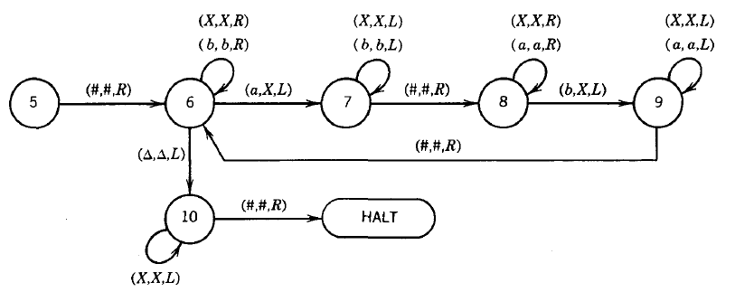
TM-EQUAL EQUAL
Theory of Automata

Slide 27
Build a TM
Language: DOUBLEWORD, the set of all words of the form ww where w is a nonnull string in {a,b}*. DOUBLEWORD = {aa bb aaaa abab baba bbbb aaaaaa aabaab . . }
Theory of Automata

Slide 28
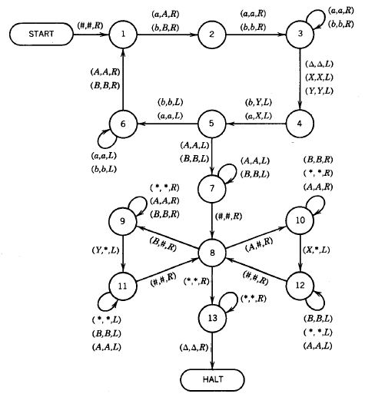
TM-DoubleWord
Build a PM-2PDA-3PDA for DoubleWord
Theory of Automata

Slide 29
Language: a^{n}b^{n}c^{n}d^{n}
Design a PM
Design a 2PDA
Design a 3PDA
Dec 3, 2012
Theory of Automata

Slide 30
Language: 3EQUAL
Let us define the language 3EQUAL over the alphabet {a,b,c} as all strings that have as many total a's as total b's as total c's.
3EQUAL = {abc acb bac bca cab cba aabbcc
aabcbc . . . }
Design a TM
Design a PM
Design a 2PDA
Design a 3PDA
Dec 3, 2012
Dec 3, 2012
Theory of Automata

